Slide 1
ANTIQUITY
ANCIENT GREEK & ROMAN ART

Slide 2
CLASSICAL ANTIQUITY
Classical antiquity (also called the classical era, classical period or classical age) is a broad term for the long period of cultural history centered on the Mediterranean Sea, comprising the interlocking civilizations of ancient Greece and ancient Rome. Together this civilization is known as the Greco-Roman world.
The Classical era lasted about 1450 years - roughly from about 1000 BCE to 450 CE. It ends with the start of the Middle Ages or Medieval Era.

Slide 3
ART DEVELOPMENTS - ANCIENT GREEKS
During this period of Classical Antiquity - known as "Classical Greek Culture" - we see the apogee of Greek Civilization, the foundation of all Western Civilization.
Classical Greek culture was immensely influential on the Romans, who exported versions of it to all parts of their empire. As a result Ancient Greek ideas and values have had a major impact on the art and architecture of the modern world, notably during the period of Renaissance art in Europe, and later during the era of Neoclassical era in 18th Europe and 19th-century America.
In fact, the humanist aesthetic and the high technical standards of Greek art continued to dominate the values of academic art in the West until the late 19th century.

Slide 4
PORTRAYING EMOTIONS
The very early Classical artists had preferred to suggest emotion by simple gestures and it was left to the minor craftsmen who carved grave reliefs to show faces contorted with grief where appropriate. Otherwise, no other expression was shown.
Hellenistic sculptors had other standards. The aim was naturalistic or dramatic and they enjoyed capturing individual emotions on the faces of subjects. Pain, fear, pleasure, amusement, drunkenness, lassitude, sleep and death were within their range by the second century, so too were all the gradations of age and, when they wanted, they could produce plausibly differentiated racial types.

Slide 5
POSING FIGURES
The main difference in appearance between Archaic (very early) Greek sculpture and the peak of Classical style and the Hellenistic style lies in the poses.
Typically, most types of the older Greek statues were constructed of four strictly frontal or profile elevations and, though usually one leg was advanced and the other drawn back, the left and right halves of the body were rigidly symmetrical.
Classical statues are still broadly four-square in design, but the balance of the standing figure is shifted so that the axis of the body becomes a long double curve, and to mitigate frontality the head is turned regularly towards the side.
In reliefs and pedimental sculpture the Archaic formula always allowed free movement, but each part of the figure was normally shown as fully frontal or profile. The Classical style encourages oblique views and even the twisting of bodies. Groupings of figures and spiral poses of individual figures either all the way up or stopping at the waist became more common during the peak of antiquity.

Slide 6
ROMAN SCULPTURE
From early times the Romans had felt the artistic influence of Greece. In 146 BC, when Greece was conquered by Rome, Greek art became inseparably interwoven with that of Rome. "Greece, conquered, led her conqueror captive" is the poet's way of expressing the triumph of Greek over Roman culture. The Romans, however, were not merely imitators, though that was a big part of their art culture.
But with the Romans art was used not so much for the expression of great and noble ideas and emotions as for decoration and ostentation. Under the emperor Augustus, who wished his empire to emulate and surpass the achievements of the golden age of Classical Greece, wealthy Romans filled their villa courtyards and gardens with fountains, sculpture, and monumental vases, many of which were decorated with motifs drawn from the Greek art produced some 500 years earlier.
As art became fashionable, it lost much of its spiritual quality. Theyborrowed many elements of their religion from the Greeks, so the Romans copied the statues of Greek gods and goddesses to go along with this. The Romans were lacking in great imagination.
The Romans did not idealize their subjects as the Greeks did and as a result many imprefections as well as individual characteristics are found in their works. In addition, the fact that the Romans reproduced and copied Greek pieces so much later meant that we have record of artworks that did not survive from that era.

Slide 7
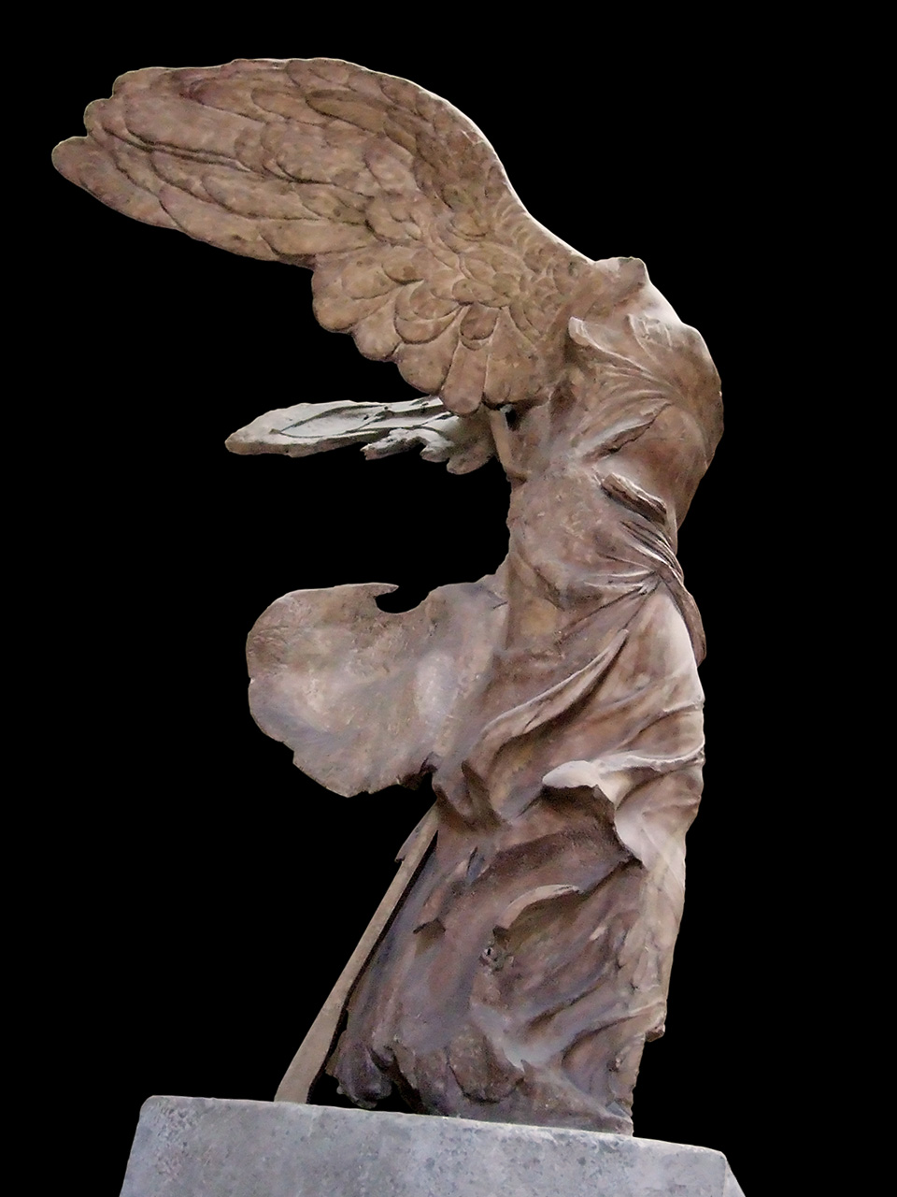
Winged Victory
Nike of Samothrace is an original example of early Greek sculpture and is made from of Parian marble. It is about six feet eight inches high and is set up on the prow (front) of a big ship. It is carved in an inferior stone and projecting obliquely into an artificial pool among carefully disposed rocks.
Because of where it was placed the Nike could be seen well, though at some distance, from in front and more closely along the left side, but the right side and the back were intended to be out of sight and so they were never finished. This explains the special care given to the appearance of the statue in the area between the front and the left lateral view.
The transition between these two views is made by a spiralling twist, though this spiral is in the drapery - in the heavy folds between the legs and the opposite system around the left hip - but the figure, if stripped, has a four-square construction.
The forms of the body are fairly Classical. The drapery the sculpture uses transparency, modelling lines and motion lines to emphasize the form of the body beneath.

Slide 8
Venus de Milo
One of the most famous examples of sculpture from Ancient Greece, the Venus de Milo is an armless marble statue of Aphrodite - the Greek goddess of love and beauty - which was sculpted during the Hellenistic period between about 130 and 100 BCE.
The statue is made from Parian marble and stands some 6 feet 8 inches tall, without its plinth.
The Venus de Milo depicts the mythological Greek goddess Aphrodite, and the story of the Judgment of Paris. In this tale, a young Trojan prince, Paris, was given a golden apple by the goddess of Discord and told to award it to the most beautiful of the three candidates: Aphrodite, Athena and Hera. Aphrodite won the beauty contest by bribing Paris with the love of the most beautiful mortal woman - Helen of Sparta - and was awarded the apple.
Sculpture reconstruction experts calculate that the separately carved right arm of the Venus de Milo lay across the torso with the right hand resting on the raised left knee, thus clasping the drapery wrapped around the hips and legs. The left arm, meanwhile, was holding up the apple at about eye level. Scholars remain divided as to whether the goddess was looking at the apple she was holding, or gazing into the distance.
In its original state, the sculpture would have been tinted with colour pigments, to create a more lifelike appearance, then decorated with bracelet, earrings, and headband, before being placed in a niche inside a temple or gymnasium. Today, however, no trace any paint remains, while the only signs of any metal jewellery are the fixture holes.
Venus de Milo is one of the most well-known statue in the history of sculpture, it is on public display in the collection of Greek sculpture at the Louvre Museum in Paris, France.

Slide 9
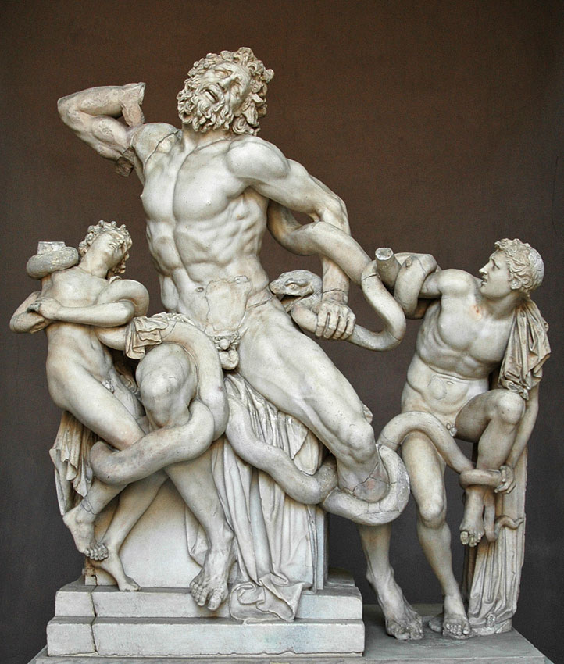
The Laocoon
The Laocoon statue, standing some 8 feet in height, is made from seven interlocking pieces of white marble. Its exact date of creation is uncertain, but experts now believe that it was sculpted between 42-20 BCE.
More importantly, it is not known for certain whether it is an original Roman sculpture or a copy of an earlier Greek sculpture.
Laocoon was a Trojan priest. When the Greeks, who were holding Troy under siege, left the famous Trojan Horse on the beach, Laocoon tried to warn the Trojan leaders against bringing it into the city, in case it was a trap. The Greek goddess Athena, acting as protector of the Greeks, punished Laocoon for his interference by having him and his two sons attacked by the giant sea serpents Porces and Chariboea. In the sculpture, one son can be seen to break free from the snakes, and looks across to see his father and brother in their death agonies.
The emotionalism in Laocoon and His Sons was highly influential on later eras of sculpture.

Slide 10
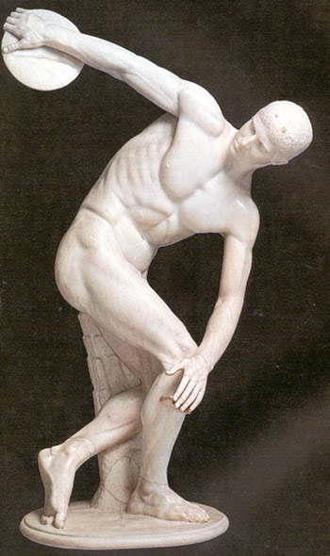
The Disc Thrower
Discobolus, was a representation of a disc-thrower - Myron captured the moment when one movement is completed and the athlete pauses for the next - he has just completed his backswing, his arm is outstretched and h
The work was widely admired for capturing the instability of an instant motion and combining it with a composition of balance and harmony. The statue was designed within a single plane, which means it was only meant to be seen from the sides. The original no longer exists but there is an excellent marble copy, made in Roman times, now housed at the Museo Nazionale Romano, Rome.e is about to commence the forward swing.
The artist, Myron, one of the ancient Greek masters created this work. As far as is known, Myron worked exclusively in Bronze, except for one statue of Hekate, which was forged in wood.

