Slide 1
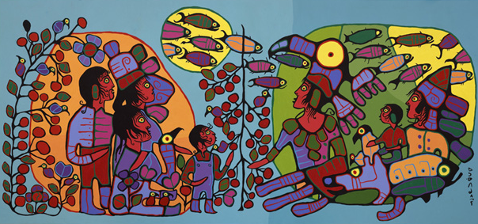
Eastern Woodland Painting
Observation of the Astral World, by Norval Morrisseau, 1990

Slide 2
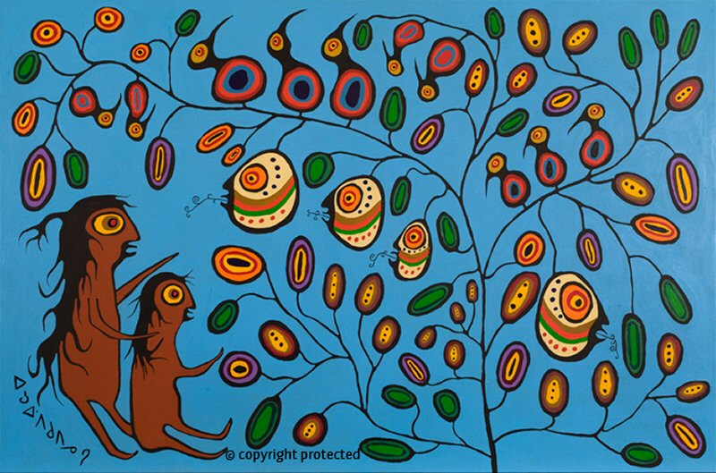
First, let’s look at some of Norval Morrisseau’s paintings…
Tales of the Story Tree, 1978

Slide 3
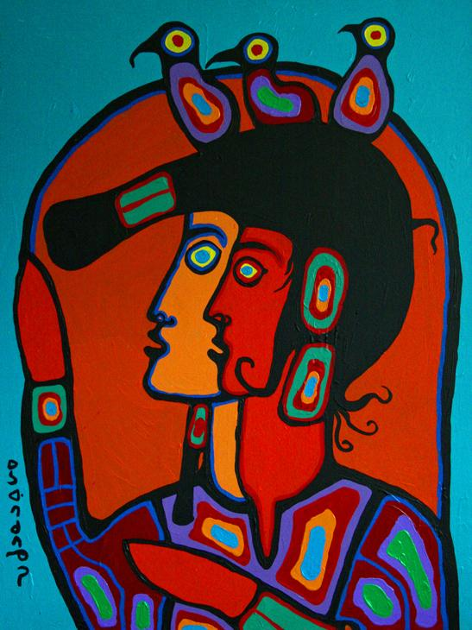
Shaman with Self Spirit, 1995

Slide 4
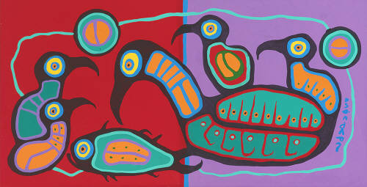
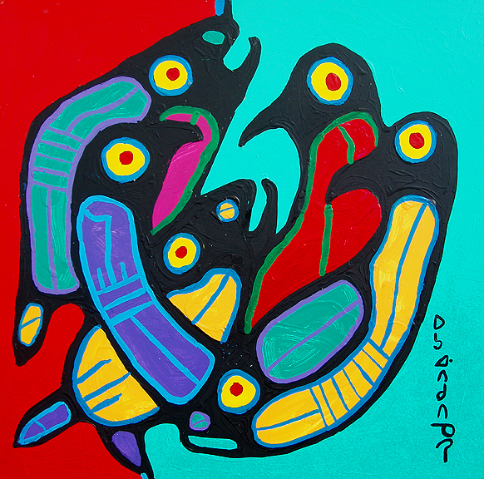
Together, 1990
Nature’s Family #2

Slide 5
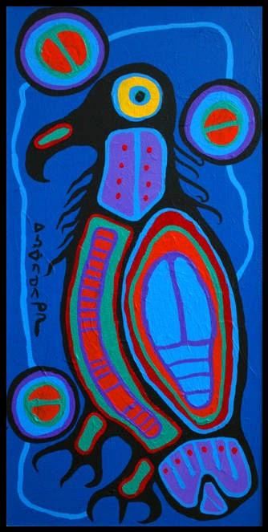
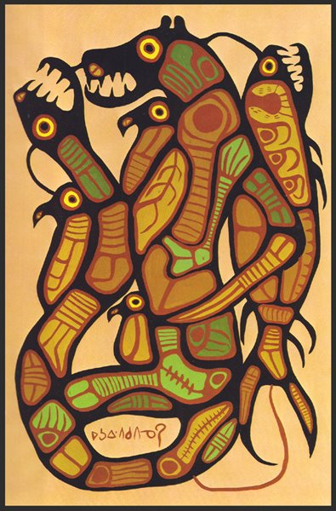
Bird, 1993
Nature’s Balance, 1975

Slide 6
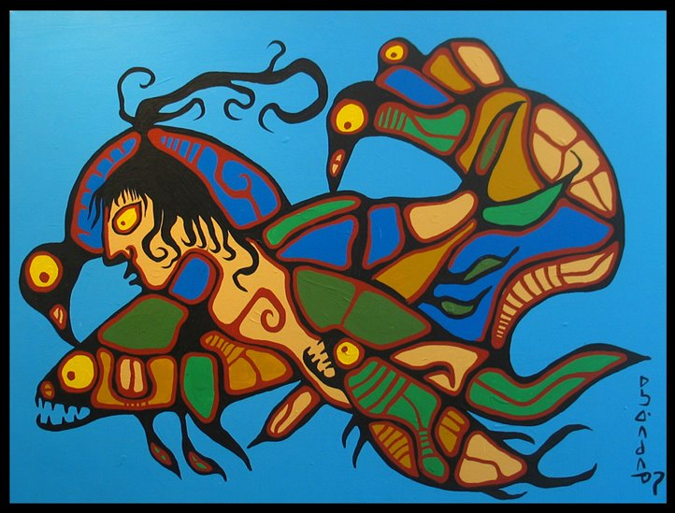
Water Legend, 1979

Slide 7
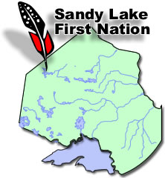
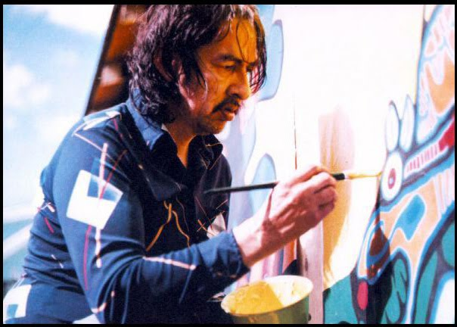
Norval Morrisseau, a brief biography…
born in the early 1930’s at Sandy Point Lake Reserve, northwest of Thunder Bay, Ontario
raised by his grandparents
from them, learned traditional Ojibwa customs, values and beliefs
given the Ojibwa name “Copper Thunderbird”
given his “mission”, which was to share through art, all that he was taught to respect about Ojibwa culture
began painting in the 1950’s
when he was hospitalized
with tuberculosis
died in 2007

Slide 8
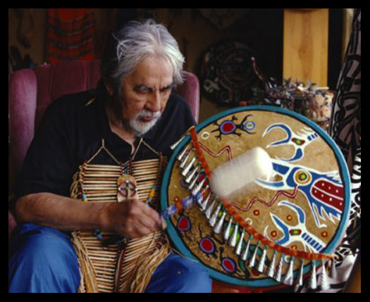
Norval Morrisseau:
was a medicine man or shaman
painted visions that were uniquely his own
travelled throughout Canada & northern Minnesota reservations → met with wise elders to learn & teach
taught by painting and writing
developed a unique painting style called Eastern Woodland Style
it has been used and modified by many other First Nations artists
http://firstpeoplesofcanada.com/fp_groups/fp_wh5.html

Slide 9
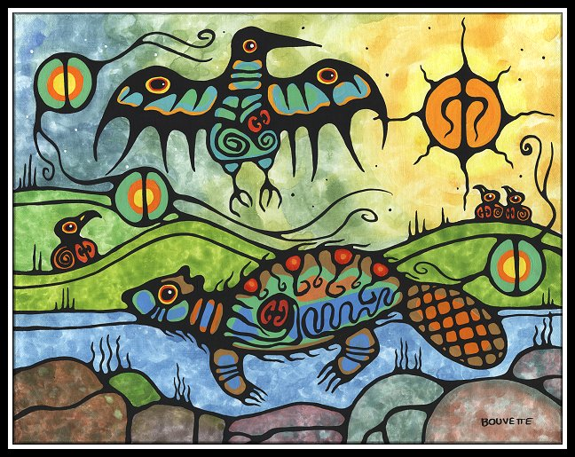
Ayla Bouvette, Beaver with Messenger

Slide 10
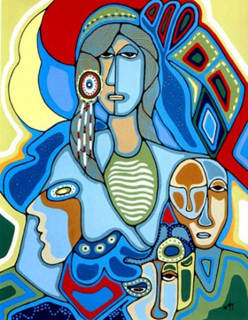
Daphne Odjig, Potawatomi

Slide 11
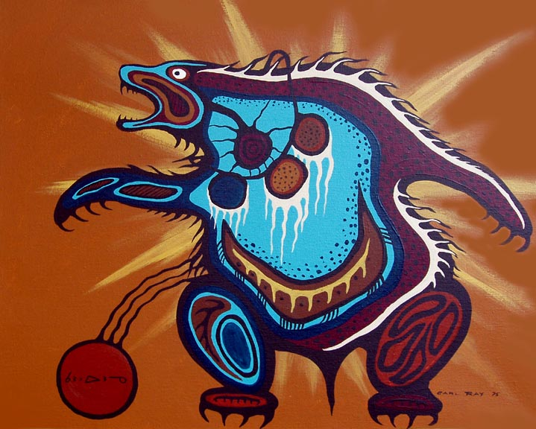
Carl Ray, Bear

Slide 12
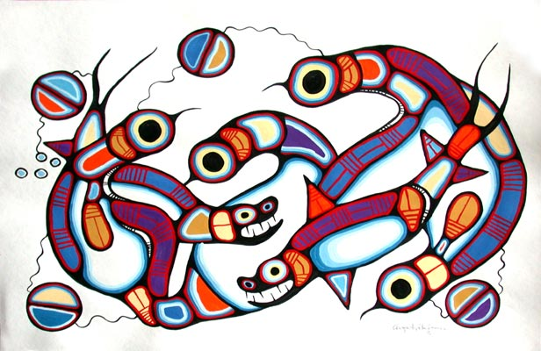
Goyce Kakegamic, Creation

Slide 13
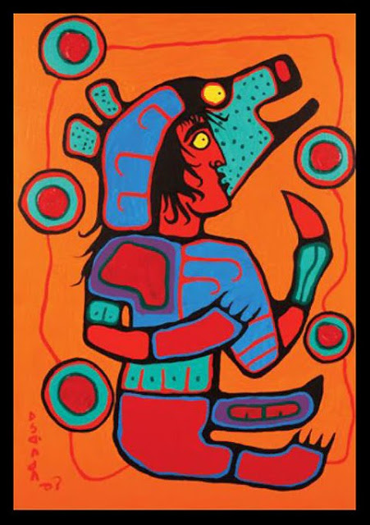
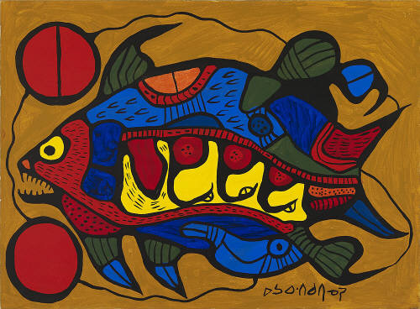
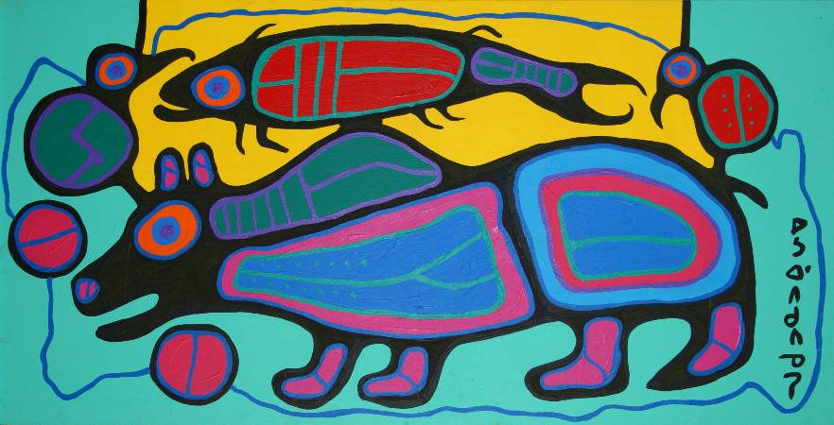
Eastern Woodland Painting usually has…
an image, usually people and/or animals
often look like x-rays to show both the interior and exterior life of the organism
a ground, usually painted in one or two large areas of flat, bright colour
simple shapes outlined in thick black & filled with bright colours that reflect the mood of the painting
symbols, pictures that tell a story without using words
no sense of place (no landscape or horizon line)
no shading, values or textures

Slide 14
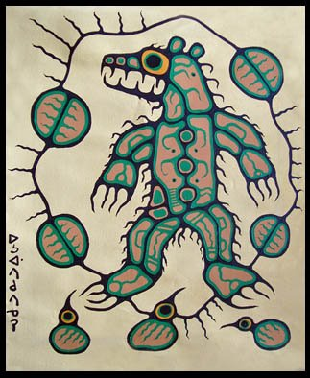
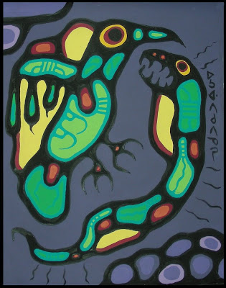
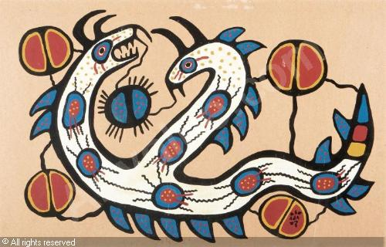
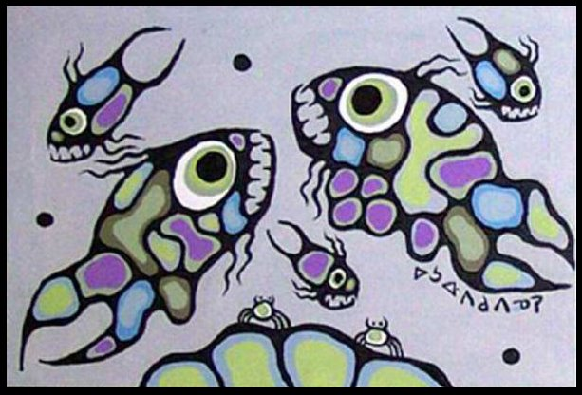
Symbolism in Eastern Woodland Painting
Examples of symbols in Morrisseau’s work are:
large eyes – the symbol of the shaman
the divided circle – shows dualities in the world like good and evil, day and night, sky and earth, honesty and dishonesty
several different kinds of lines:
- lines of power radiate out from the head and/or body
- communication lines connect creatures and show interdependence of two beings and their relationships in nature
- small movement lines in and around a body can show shaking, for example, or a heart beating
solid balls or seeds represent spirit power, often float within the picture
circles – sacred to First Nations spirituality; the life cycle, the sun, the moon, and the directions (north, south, east, west)

Slide 15
lines of communication
divided circle
large eyes
large eyes
X-ray
X-ray
lines of power

Slide 16
lines of communication
lines of communication
lines of communication
thick black contour lines
circle = the sun
lines of movement
thick black lines
solid dots or seeds

