Slide 1
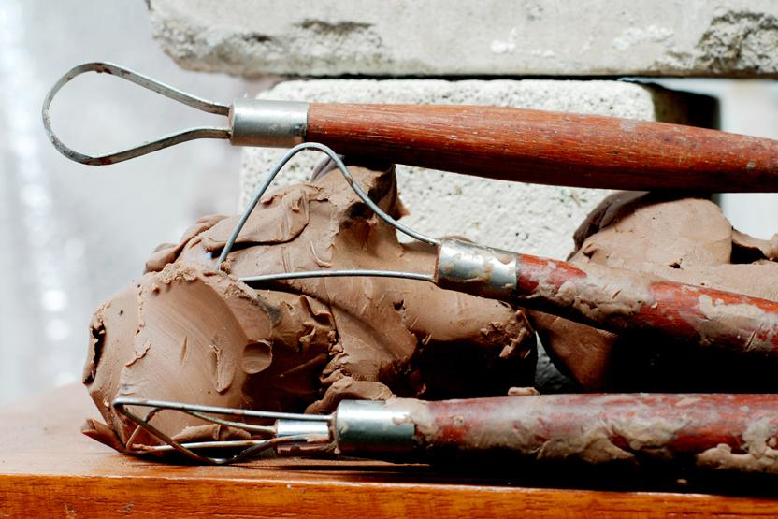
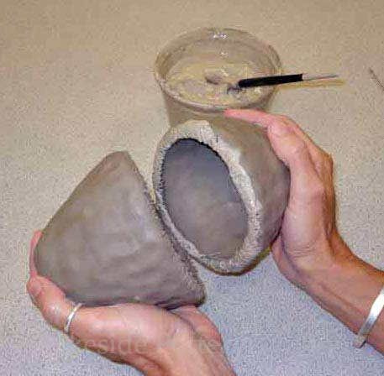
HANDBUILDING POTTERY:
Pinch Pot Creatures

Slide 2
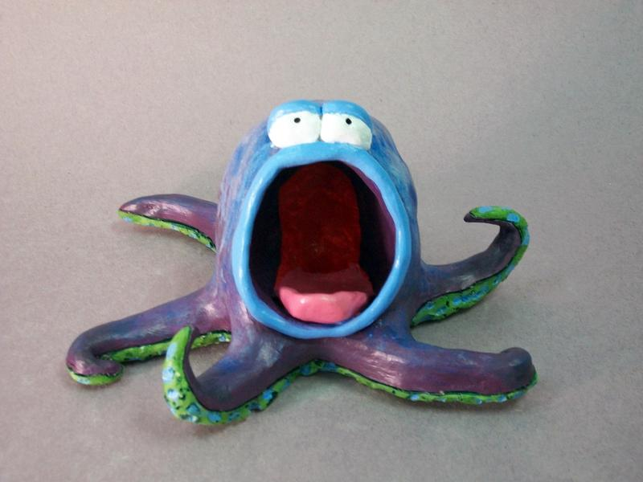
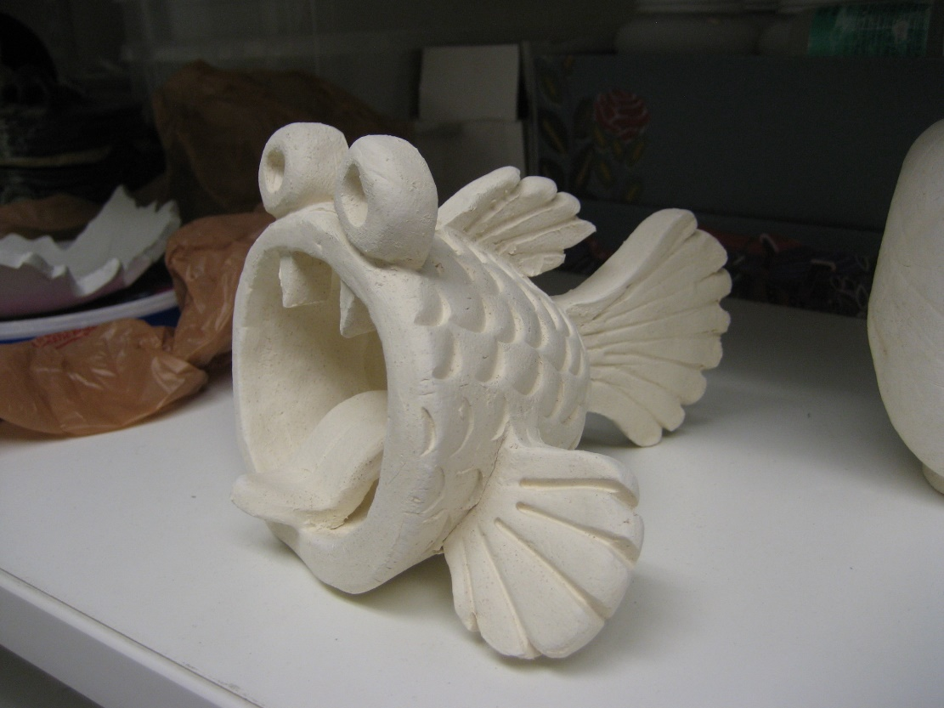

Slide 3
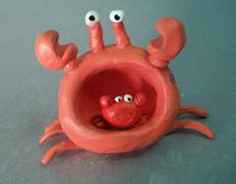
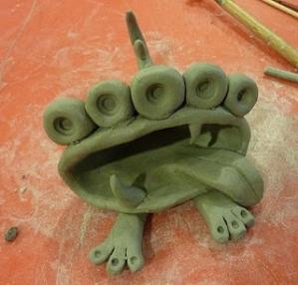

Slide 4
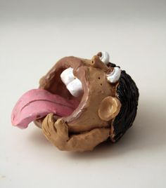
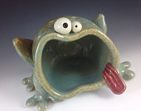

Slide 5
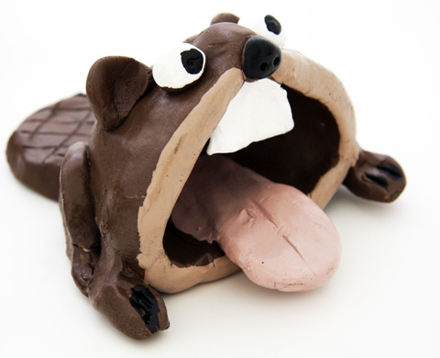
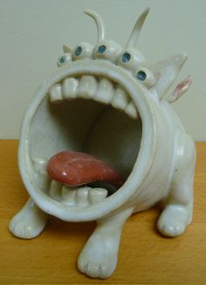

Slide 6
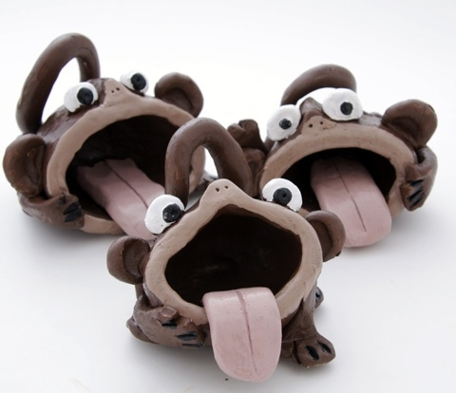

Slide 7
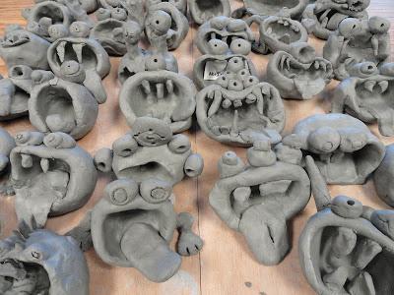

Slide 8
FINE ART
VS
DESIGN
VS
CRAFT

Slide 9
FINE ART IS A WORK THAT WAS MADE PURELY TO BE AESTHETIC

Slide 10
DESIGN IS A WORK THAT IS BOTH AESTHETIC AND ALSO HAS A FUNCTION

Slide 11
CRAFT IS A WORK THAT IS AESTHETIC AND HAS A FUNCTION AS WELL AS A CULTURAL TRADITION

Slide 12
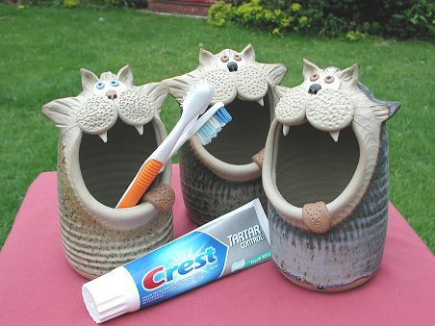

Slide 13
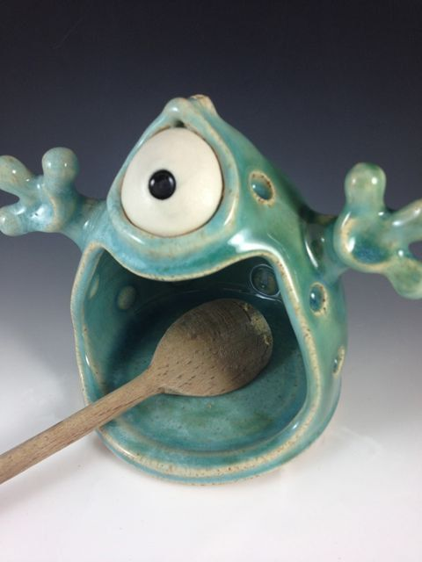

Slide 14
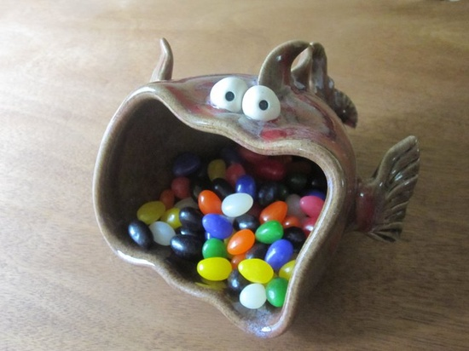

Slide 15
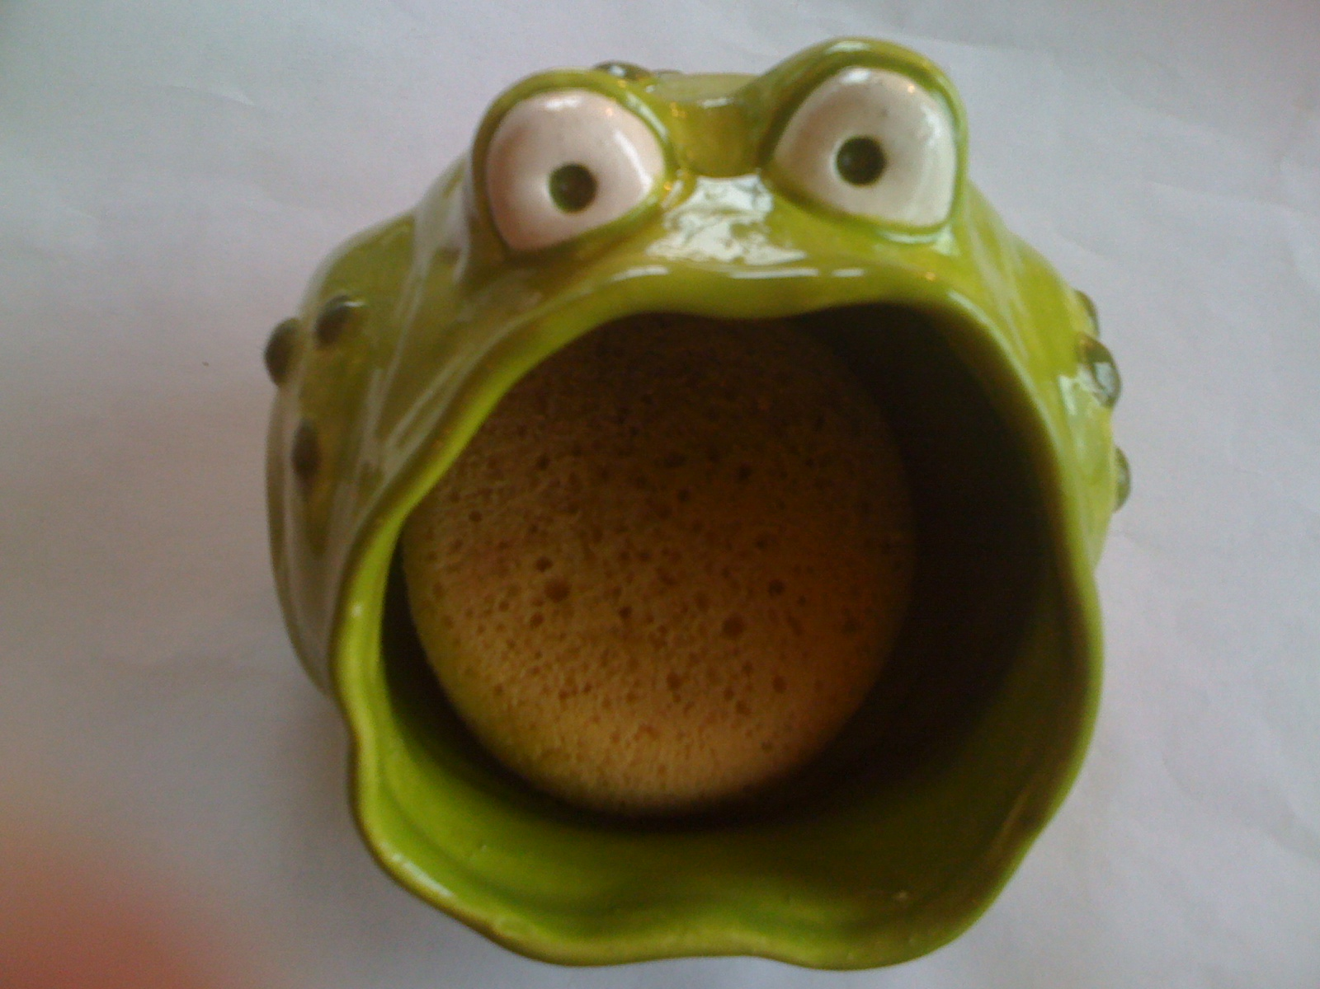

Slide 16
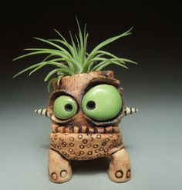

Slide 17
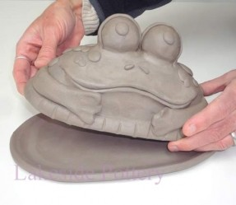

Slide 18
Wedge Clay
Form into ball
Roll ball and make very smooth.
Push your thumb into the ball of clay to form a pinch pot.
Turn punch pot on its side.
Shape mouth opening based on what your purpose will be for your creature.
Score and Slip features onto the pot to create creatures.

Slide 19
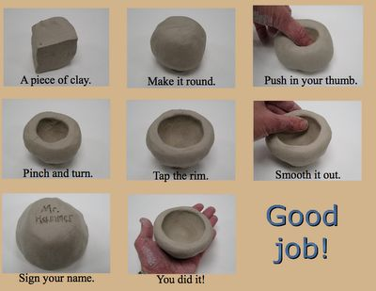

Slide 20
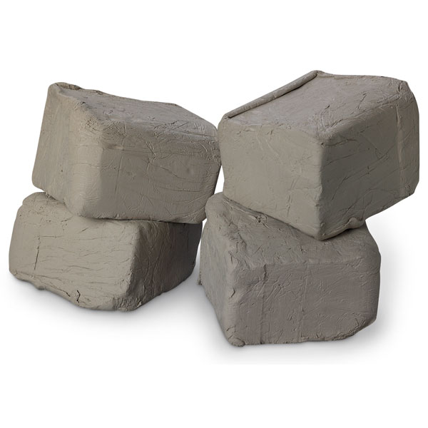
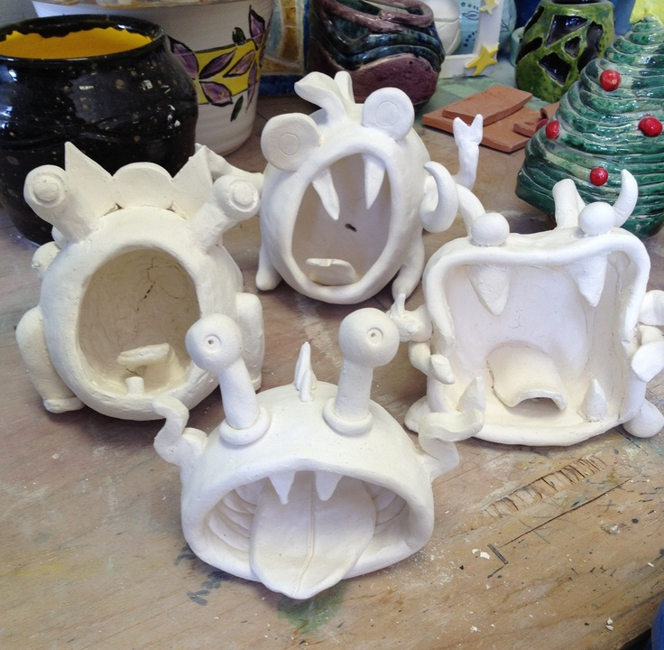
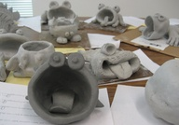
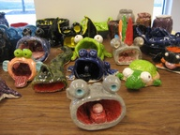
IDENTIFY: Earthenware, Leather Hard, Bisqueware, Glazeware

