Slide 1
ROBERT INDIANA
Sept 13, 1928 – May 18, 2018

Slide 2
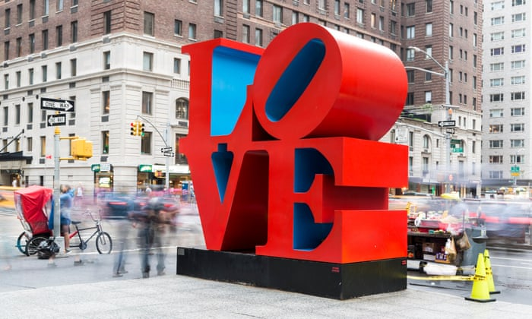
Artist: Robert Indiana
Dimensions: 3.66 m x 3.66 m x 1.83 m
Created: 1970
Medium: Cor-ten steel

Slide 3

On Valentine’s Day, February 14, 1973, the U.S. Postal Service issued Indiana’s design as a commemorative stamp.

Slide 4
“SOCIAL COMMENTARY”
For most viewers, Love denotes a feeling or experience, possibly a concept and certainly a noun, but the word can also be read as a verb, even an exhortation. The “O” is on the move, but this does not mean that it is running smooth.
The work’s political context was the 60s counterculture stirred up by the Vietnam war and the civil rights movement; its personal connections were with Indiana’s lover, the abstract artist Ellsworth Kelly, from whom he parted at this time

Slide 5
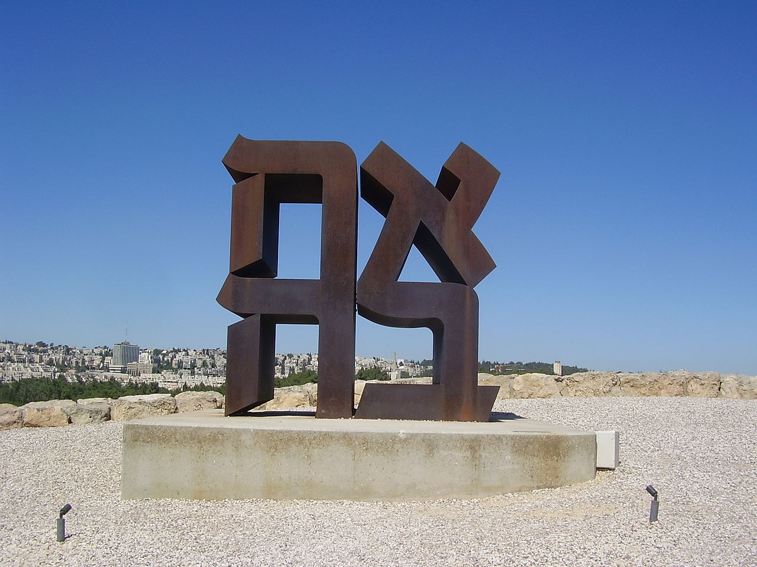
Ahava (אהבה " “ love" in Hebrew), Cor-ten steel sculpture by Robert Indiana (American), 1977, Israel Museum, Jerusalem

Slide 6
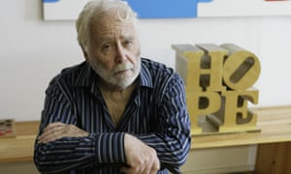

Slide 7
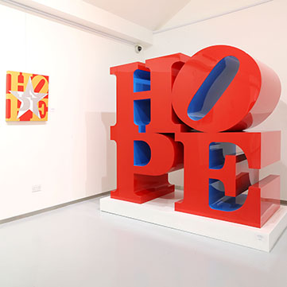
Artist: Robert Indiana
Created: 2009
Period: Pop art
Genre: Kinetic art

Slide 8
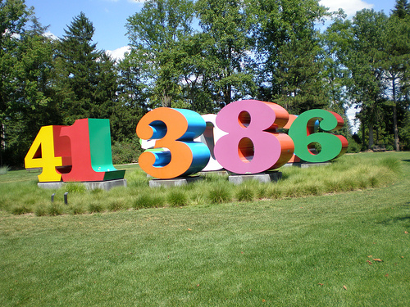
Artist: Robert Indiana
Created: 1983
Owner: Newfields
Dimensions: 2.4 m × 2.4 m × 1.2 m (8 ft × 8 ft × 4 ft)
Location: Indianapolis Museum of Art, Indianapolis, Indiana

Slide 9
These ten objects are fabricated from sheets of cut and rolled aluminum into the forms of Arabic numerals, or “numbers.” Each number is 8' tall, 8' wide, and 4' deep, and weighs between 600 and 1000 lbs. Each number is painted with a two-color scheme: one color for the front and back sides, and then a separate color for the interior and exterior panels. The range of colors includes four shades of blue and red; three shades of green; two shades of orange, yellow, and white; and one shade of purple, grey, and black.
The numbers are not exhibited in numerical order; they have been arranged by the artist to represent dates of personal significance. Each number is mounted onto a custom-fit aluminum base (resting on a center post) that rests on a square concrete block. All numbers are approximately the same total height and width, but vary in linear design depending on the shape of the number.
The artist’s name, year of production (varies from 1980–1983), copyright symbol, and the foundry mark (Lippincott) have been stamped into either the right or left side of each number.
The sculpture’s appeal and accessibility spring from the artist’s use of everyday material—numbers, rich colors, and the typography of advertising. Though Indiana is best known as a Pop art artist, his color choices—vivid hues and contrasts between different surfaces—and the manner in which the numbers are arranged together—staggered, overlapping, nonlinear—reflect his interest in Op-Art.

Slide 10
The numbers and their colors were identified to represent the stages of man in this way:
    1, red and green: birth;
    2, blue and green: infancy
    3, orange and blue: youth
    4, red and yellow: adolescence
    5, blue and white: pre-prime of life
    6, red and green: prime of life
    7, blue and orange: early autumn
    8, orange and purple: autumn
    9, yellow and black: warning
    0, shades of gray: death.
Indiana had been working with the 10 numbers two-dimensionally since the late 1950s, but Numbers 1-0 was his first opportunity to realize them in sculptural form.
He sees each number as being both an abstract idea and a representation of the physical presence of numbers in life; he associates many significant memories from his own life with numbers.

Slide 11

Political and social engagement also inspired Indiana’s later career. In the first decade of this century he responded to terrorist attacks and Middle Eastern invasions with such images as Afghanistan (2001) and the Peace series (2003), while during the run-up to Barack Obama’s election as US president in 2008, Indiana projected the configuration of Love on to a related sentiment, Hope.

Slide 12

Hope Day was inspired by artist Robert Indiana’s 2010 interview with The Today Show, in which he said, “I’d like to cover the world with HOPE.” He believes that, as with the iconic Robert Indiana work LOVE, which became a symbol of positivity during the turbulent 1960s, four letters can change the world. And he arranges them in such a way as to make them inescapable. Robert Indiana created HOPE in 2009 with the belief that the world was ready for a new message. HOPE suggests light and illuminates a path to a better world. The “O” in HOPE leans forward, propelling us to look forward to the promise of a better, more peaceful future.

